Slide 1
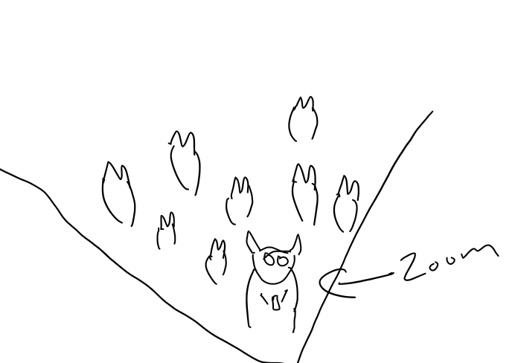
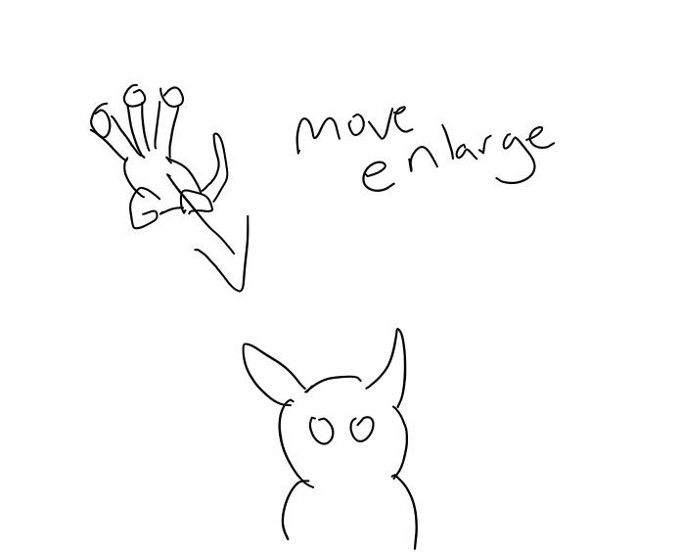
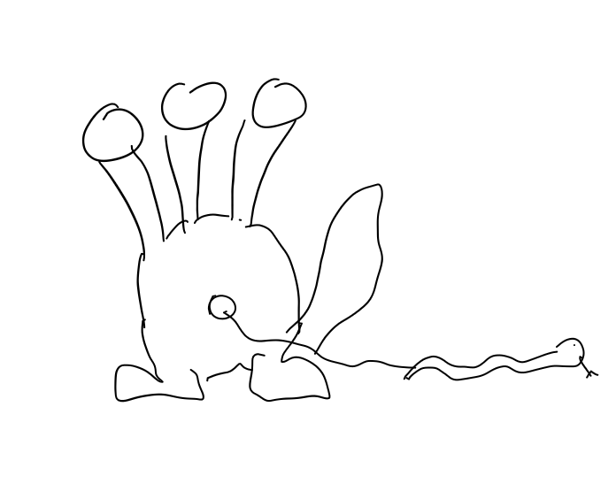
Mongoose Security
1,2,3
1
intro
Intro shot with main party
Character surrounded by others.
Zoom in from a herd to main
Calm music
Zoom in slow
Character intro of unaware
Party that will be using app surrounded by a herd mentality wanting to fit in.
2
Hydra Intro
Introduction of hydra with
The heads of social media
Appearing in background
Darkish music
Pan zoom from cow to hydra
Hydra small at start
And becomes large to loom over the cow
3
Snake appear
Snake appears from hydra
Snake from hydra stomach
Darkish music
Normal view
Snake appears from portal
Of hydra stomach connected via a lan cable

Slide 2
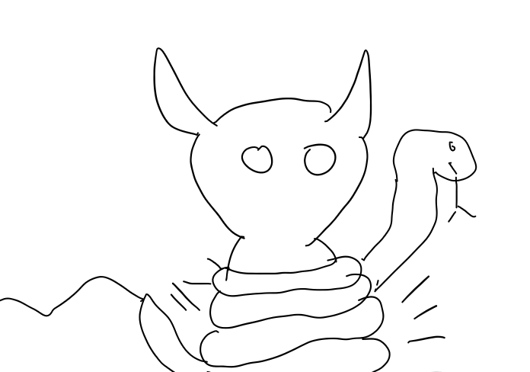
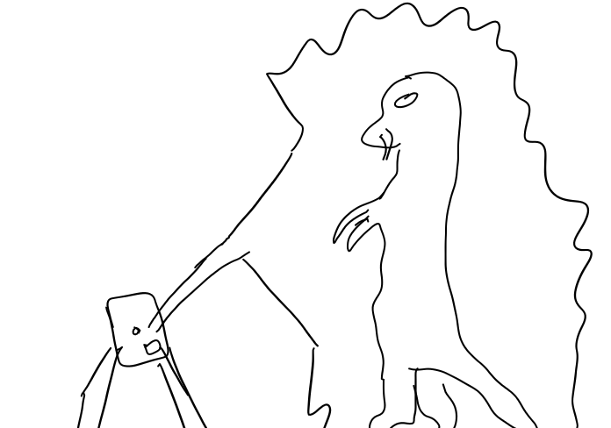
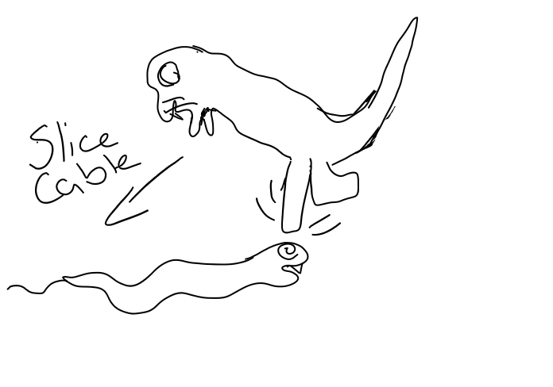
Mongoose Security
4,5,6
4
Snake coil
Cow becomes coiled
a
Coiling
Darkish music with some dialog
Normal view
Throbbing snake around cow
As it gets coiled the cow become pale bubbles show data.
5
Hero entry
Enter the mongoose
To protect the cow
Hero enters the scene
Dark to Heroic/dialog
Pan out to full view
Mongoose on phone
Pops out to help out the cow and face to face dialog and talking to snake
6
Fight scene
Fight scene
Snake coil mongoose kick
Fight music
Multi sliding
Snake coils to strike
Mongoose jumps kicks and breaks lan cable

Slide 3
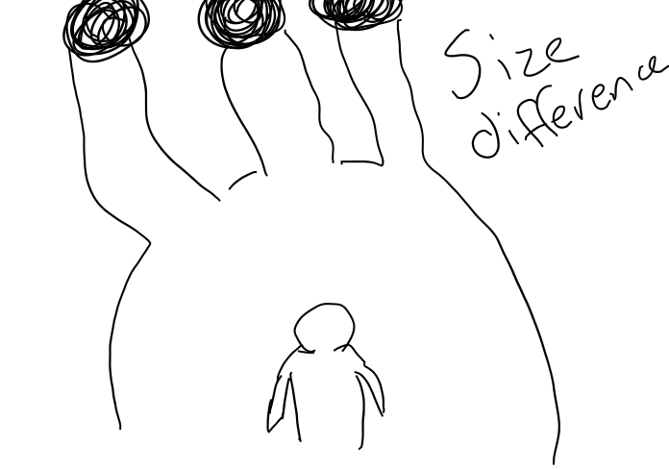
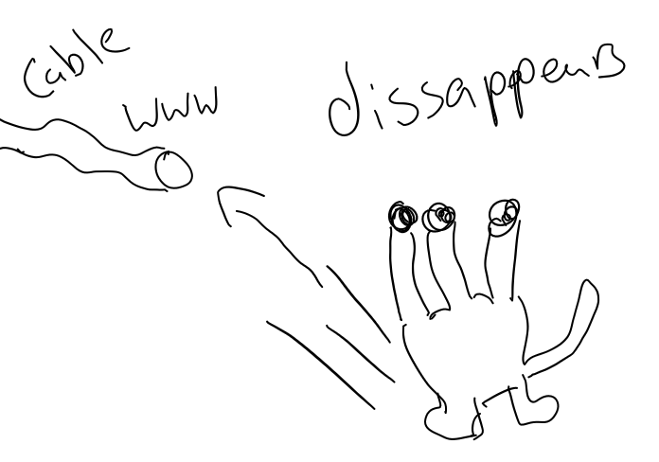
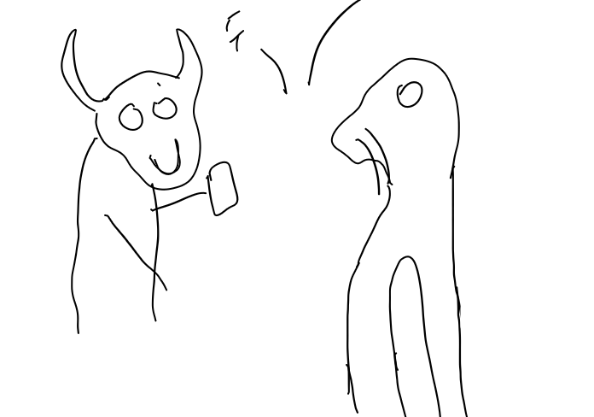
Mongoose Security
7,8,9
7
Defeat
Snake defeat
Mongoose vs hydra
Showdown
Fight music
Jump back and forth between
Snake defeated
Hydra and mongoose showdown with dialog and hydra conciets defeat
8
Success
Hydra retreat
Hydra retreating
Dark music
Normal view
Hydra retreats into
The unknown knowing it can't defeat mongoose at this time.
9
Finale of Cartoon
Final dialog scene
Dialog scene
Dialog only
Cut to each character
Dialog from successful
Protection of user and how they user can help.

Slide 4
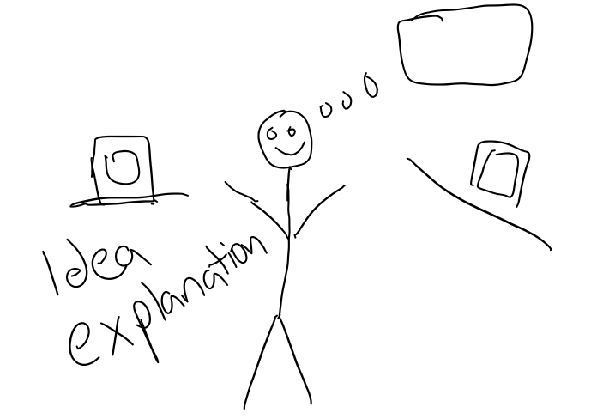
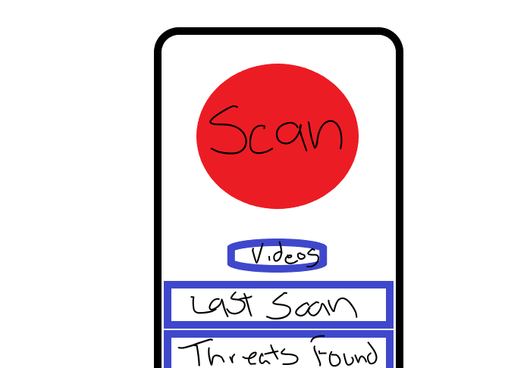
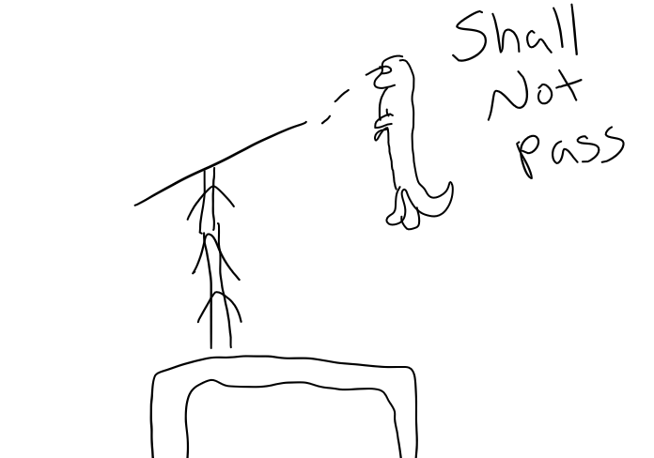
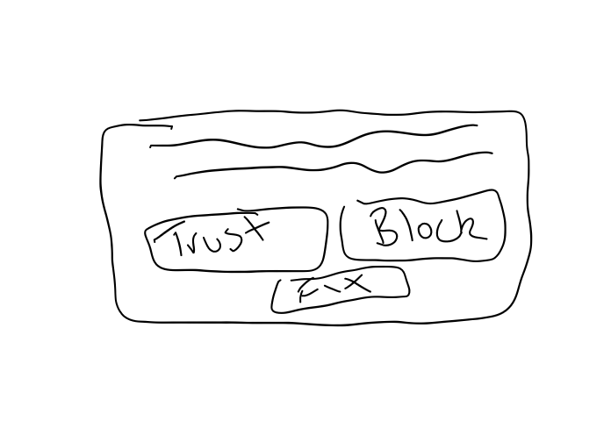
Mongoose Security
10,11
10
Intro to Development
11a
Main ui
Talking from development
Main ui
Dialog only
Dialog only
Walk and talk
App screen capture
Intro from the
Showing ui hud
Development team
With options for user
11b
Data transfer
11c
Ui boxs
Halt of data
Showing the choices
Dialog only
Dialog only
Screen capture
Screen capture
Showing how protection
Showing of ui box
Works to secure user
User can choose how they want to work

Slide 5
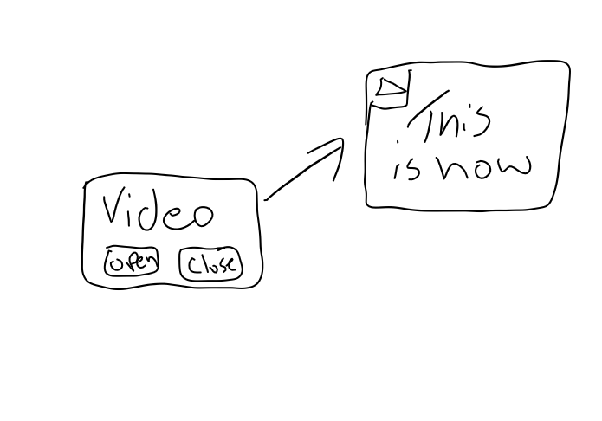
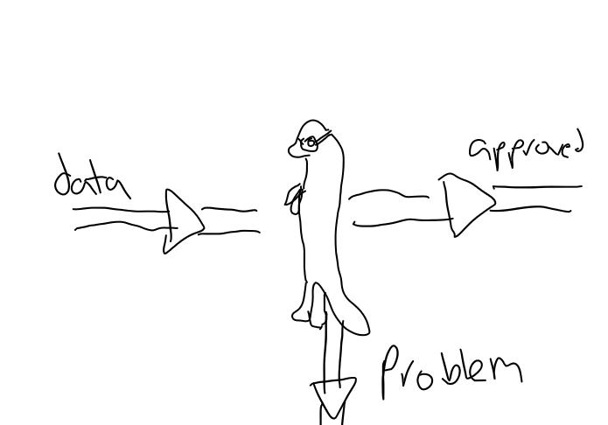
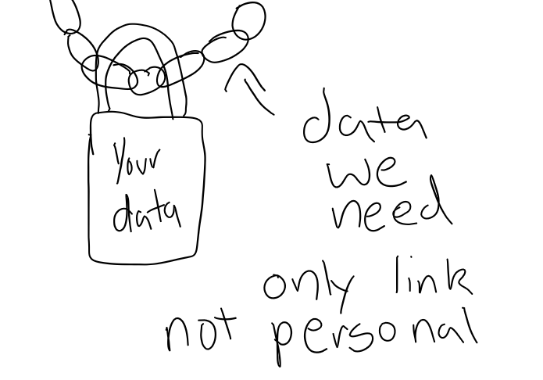
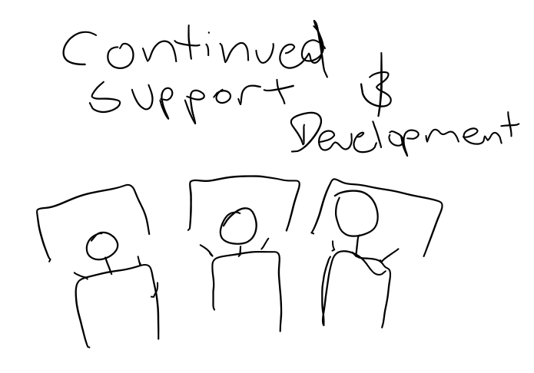
Mongoose Security
11
11d
Tutorial videos
11e
Data reading
Tutorial video
Data reading
Dialog only
Dialog only
Screen capture
Screen capture
Showing of turorials
Shows the data reading
Eg of a video popup
Of user sent packets
11f
Security
11g
Future
polocies
Where the app will go
Dialog only
Dialog
Showing of packet reads
Workstation/development
Shows user they
Showing the work put
Don’t compromise by sharing data with us instead
In by the team and continued support

Slide 6
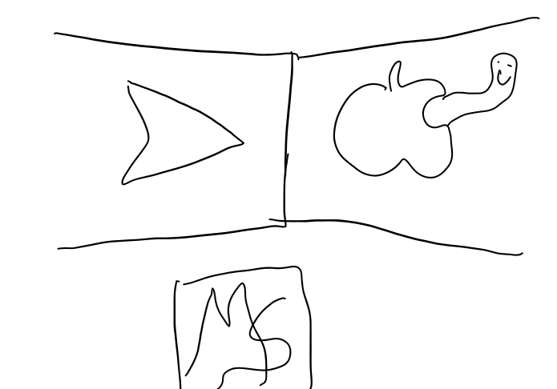
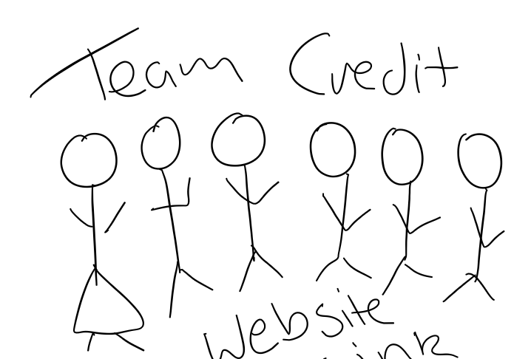
Mongoose Security
12,13
12
Market
13
Credit roll
Where can user get it
Credit roll
Dialog
Dialog
Screen captures
Development walk and talk
Shows app logo on app
Info of the team
Store and the play store
Where they can look for the nitty gritty

